Slide 1
Fast Fourier Transform
Advanced Methods for Scientific Computing
Course project
Giorgio Miani – Pietro Pasquini – Alessia Valgoi

Slide 2
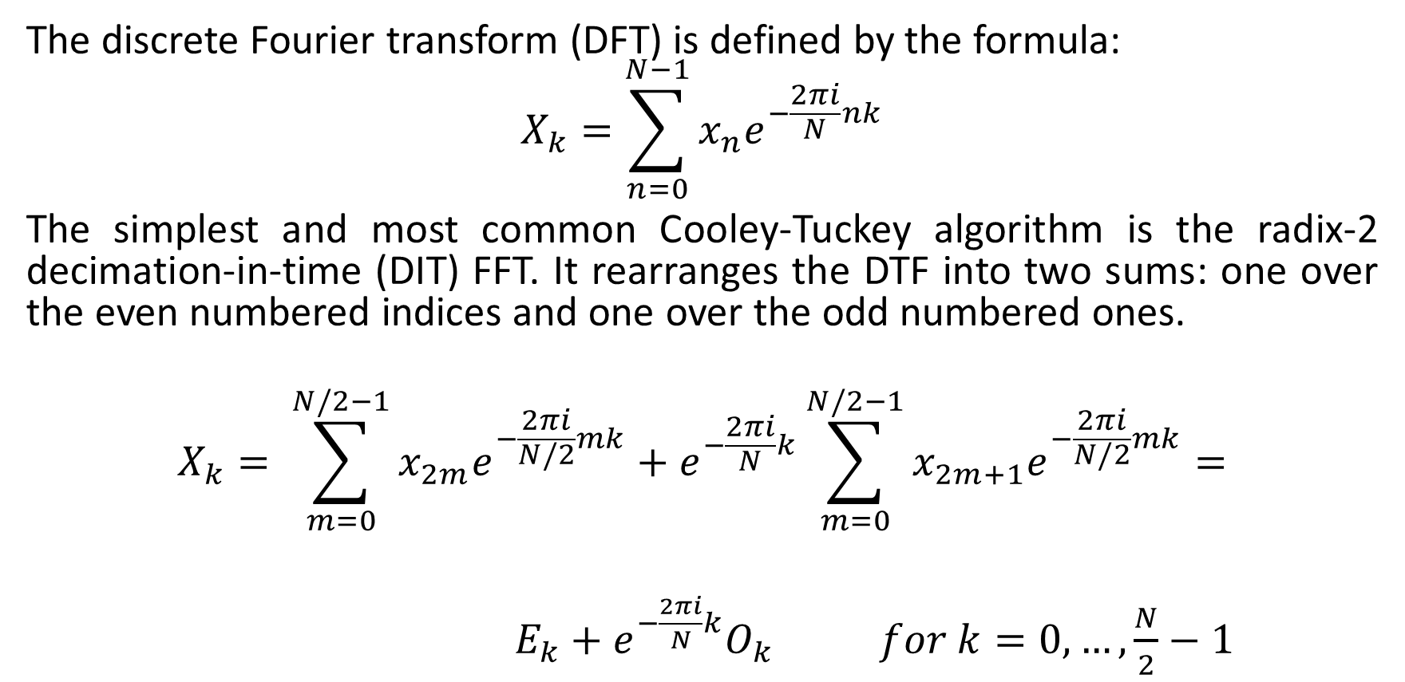
Cooley–Tukey FFT algorithm
The discrete Fourier transform (DFT) is defined by the formula:
$$X_{k}=\sum_{n=0}^{N−1}{x_{n}e^{−\frac{2πi}{N}nk}}$$
The simplest and most common Cooley-Tuckey algorithm is the radix-2 decimation-in-time (DIT) FFT. It rearranges the DTF into two sums: one over the even numbered indices and one over the odd numbered ones.
$$X_{k}= \sum_{m=0}^{N/2−1}{x_{2m}e^{−\frac{2πi}{N/2}mk}}+e^{−\frac{2πi}{N}k}\sum_{m=0}^{N/2−1}{x_{2m+1}e^{−\frac{2πi}{N/2}mk}}=$$
$E_{k}+$ $e^{−\frac{2πi}{N}k}O_{k} for k=0,…,\frac{N}{2}−1$

Slide 3
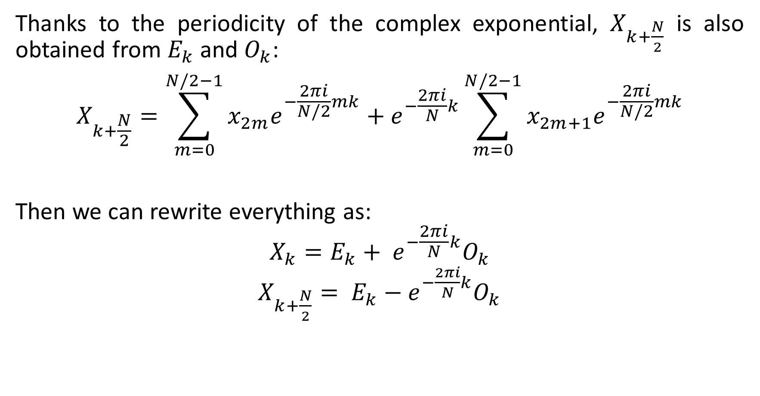
Thanks to the periodicity of the complex exponential, $X_{k+\frac{N}{2}}$ is also obtained from $E_{k}$ and $O_{k}$:
$$X_{k+\frac{N}{2}}=\sum_{m=0}^{N/2−1}{x_{2m}e^{−\frac{2πi}{N/2}mk}}+e^{−\frac{2πi}{N}k}\sum_{m=0}^{N/2−1}{x_{2m+1}e^{−\frac{2πi}{N/2}mk}}$$
Then we can rewrite everything as:
$$X_{k}=E_{k}+ e^{−\frac{2πi}{N}k}O_{k}$$
$X_{k+\frac{N}{2}}= E_{k}−$ $e^{−\frac{2πi}{N}k}O_{k}$

Slide 4
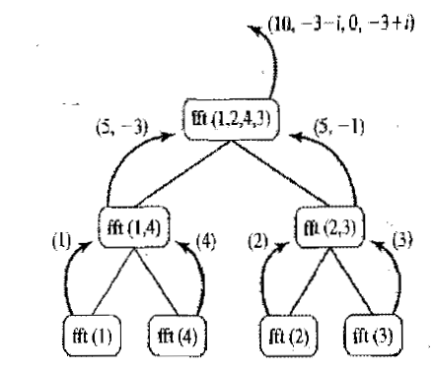
Recursive algorithm
We can implement the Cooley-Tuckey algorithm by writing a recursive function that exploits the symmetry we saw in the previous slide by dividing the inputs between those that have even and odd indexes at each step.

Slide 5
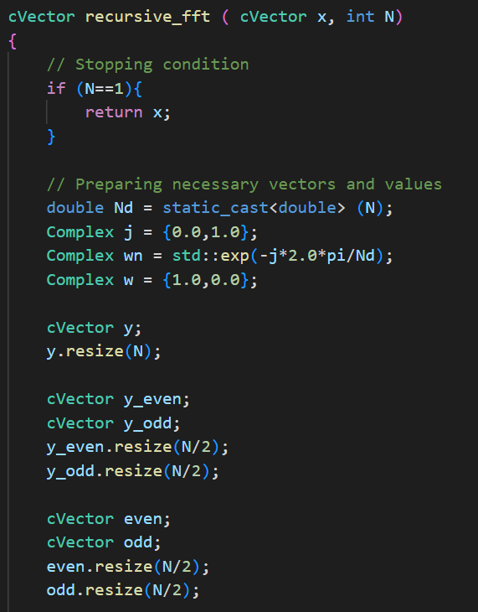
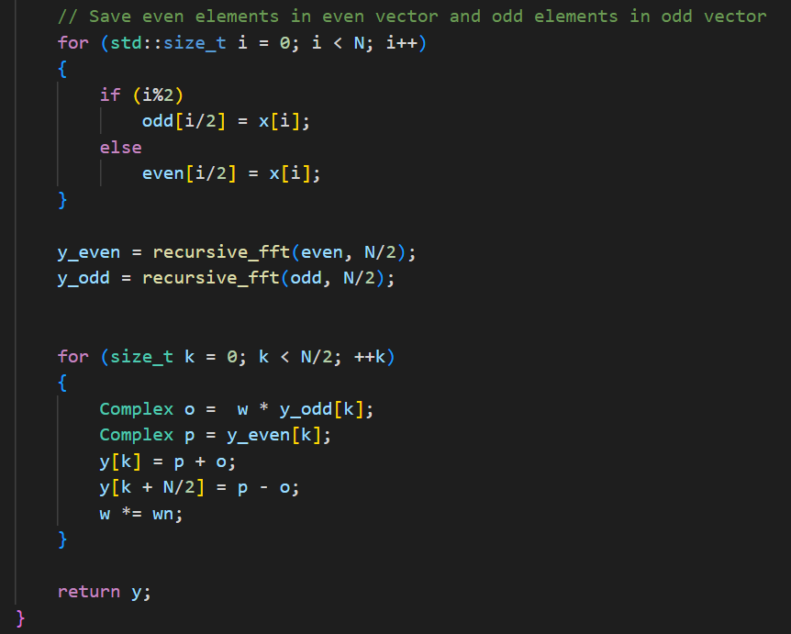
The code

Slide 6
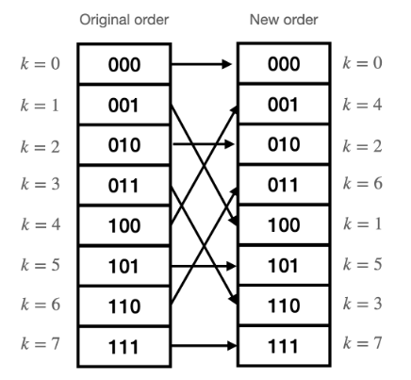
Iterative algorithm
Although it is the simplest solution, in general it is better to avoid recursive algorithms because they are less efficient and, in this case, more complex to parallelize.
We then write an algorithm that doesn’t need recursion.
First, we modify the order of the inputs using a bit reversal algorithm: by doing so, the first two elements of the new vector will be the result of the recursive selection of even inputs, the next two of the selection of even inputs at every step apart form the last, and so on.

Slide 7
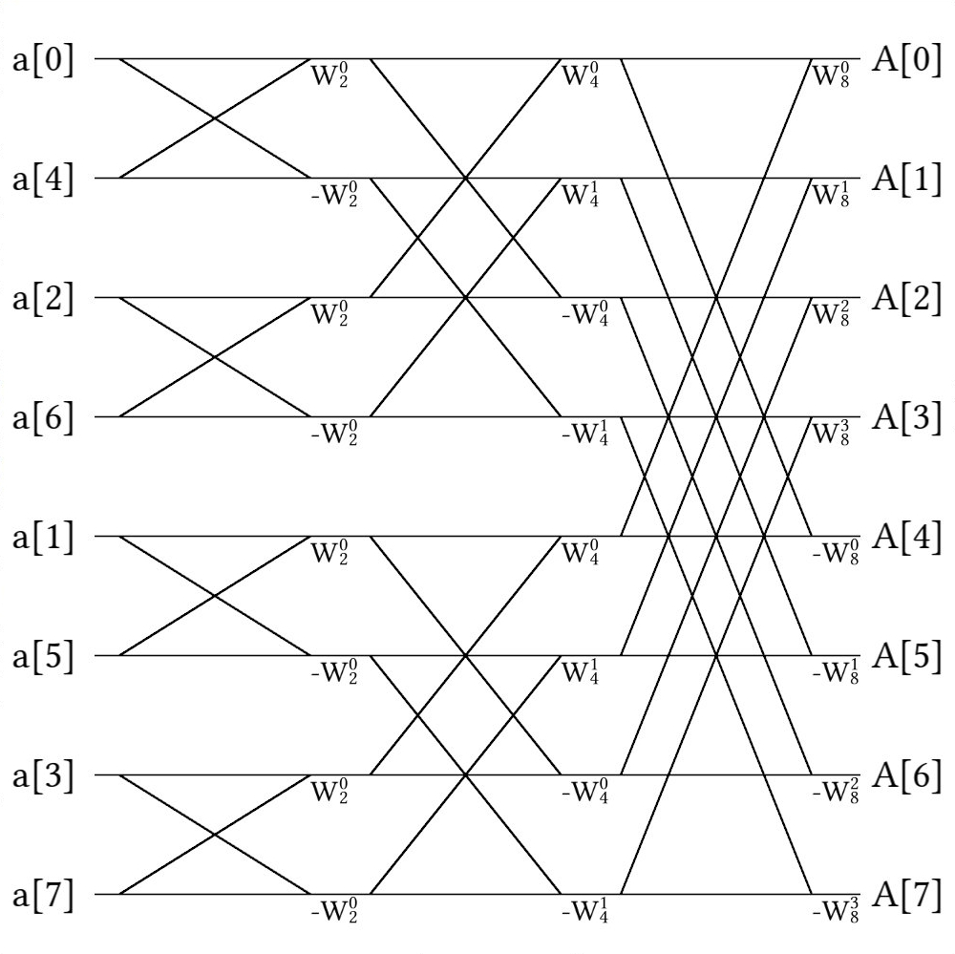
Then, after properly reordering the values, we can proceed by writing the same operations that the recursive algorithm would have done.

Slide 8
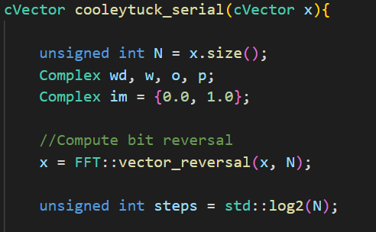
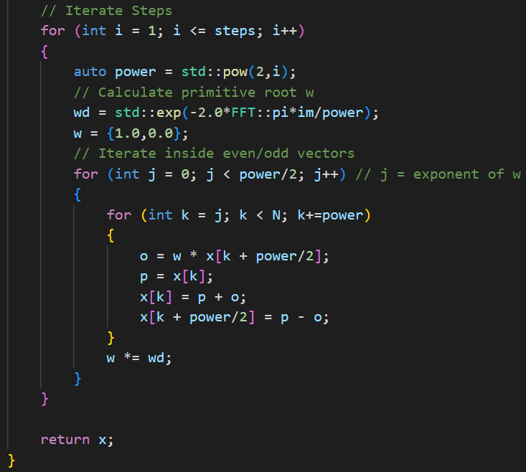
The code

Slide 9
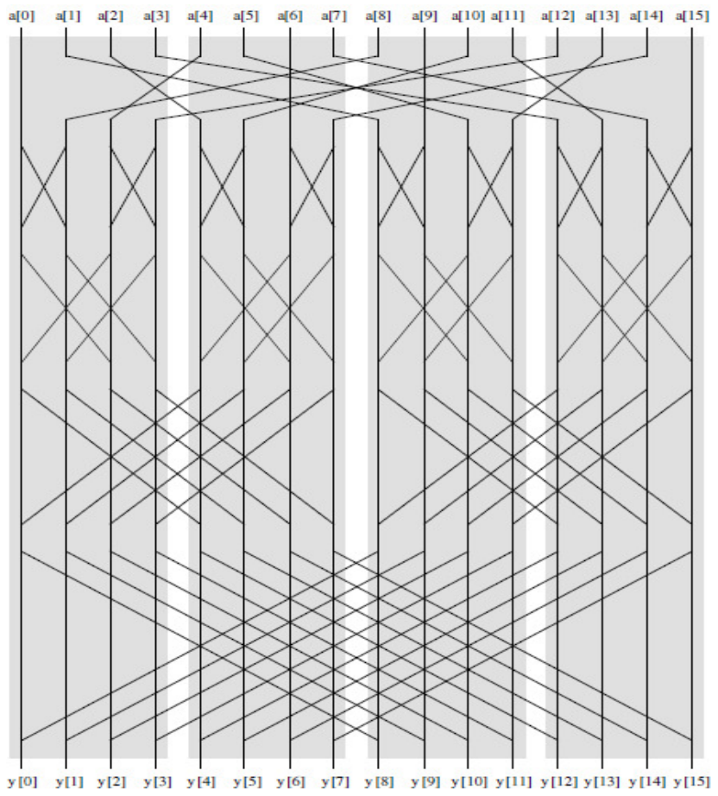
Parallel algorithm
The parallel algorithm can be divided into 3 phases.
PHASE 1
PHASE 2
PHASE 3

Slide 10
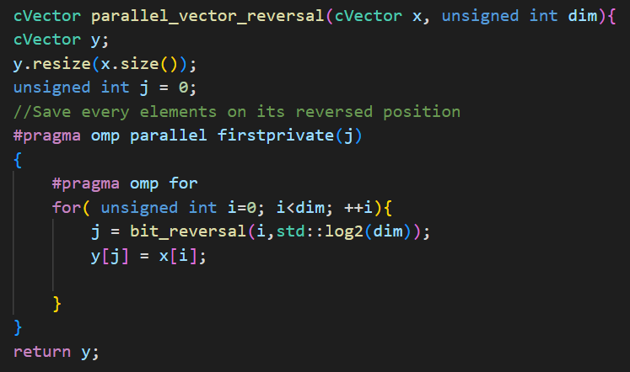
Phase 1
Phase 1 is the reordering phase using the bit reversal algorithm. We parallelized it using OMP

Slide 11
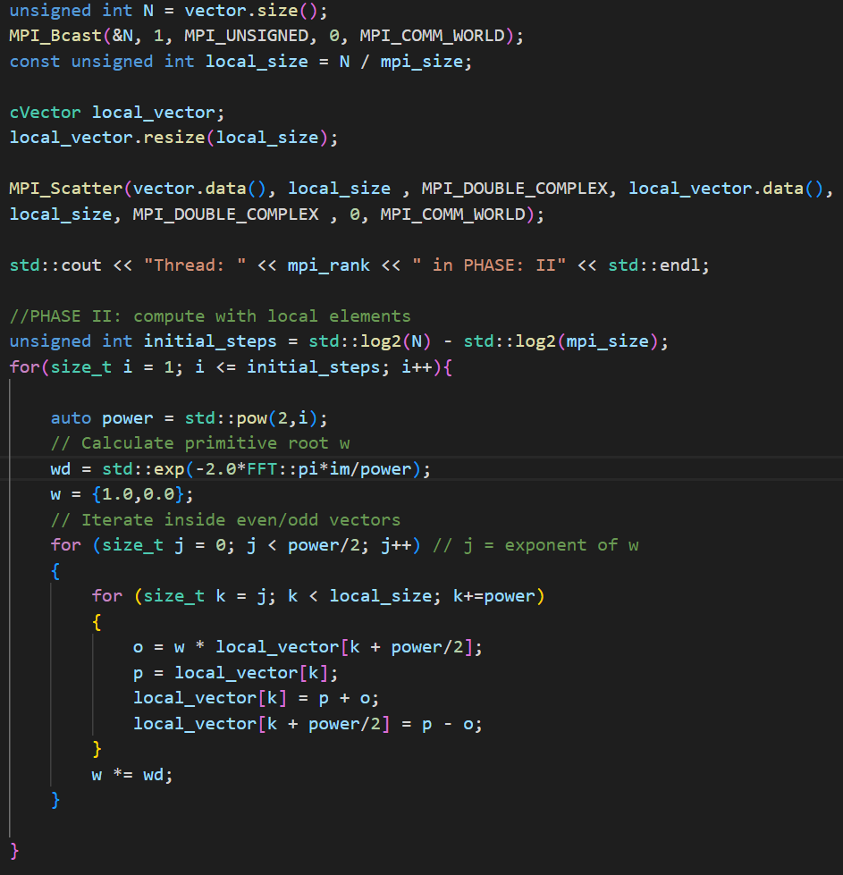
Phase 2
During phase 2 the threads can execute the iterative algorithm independently because all the necessary data has been scattered to its respective thread, so there is no need for communication.

Slide 12
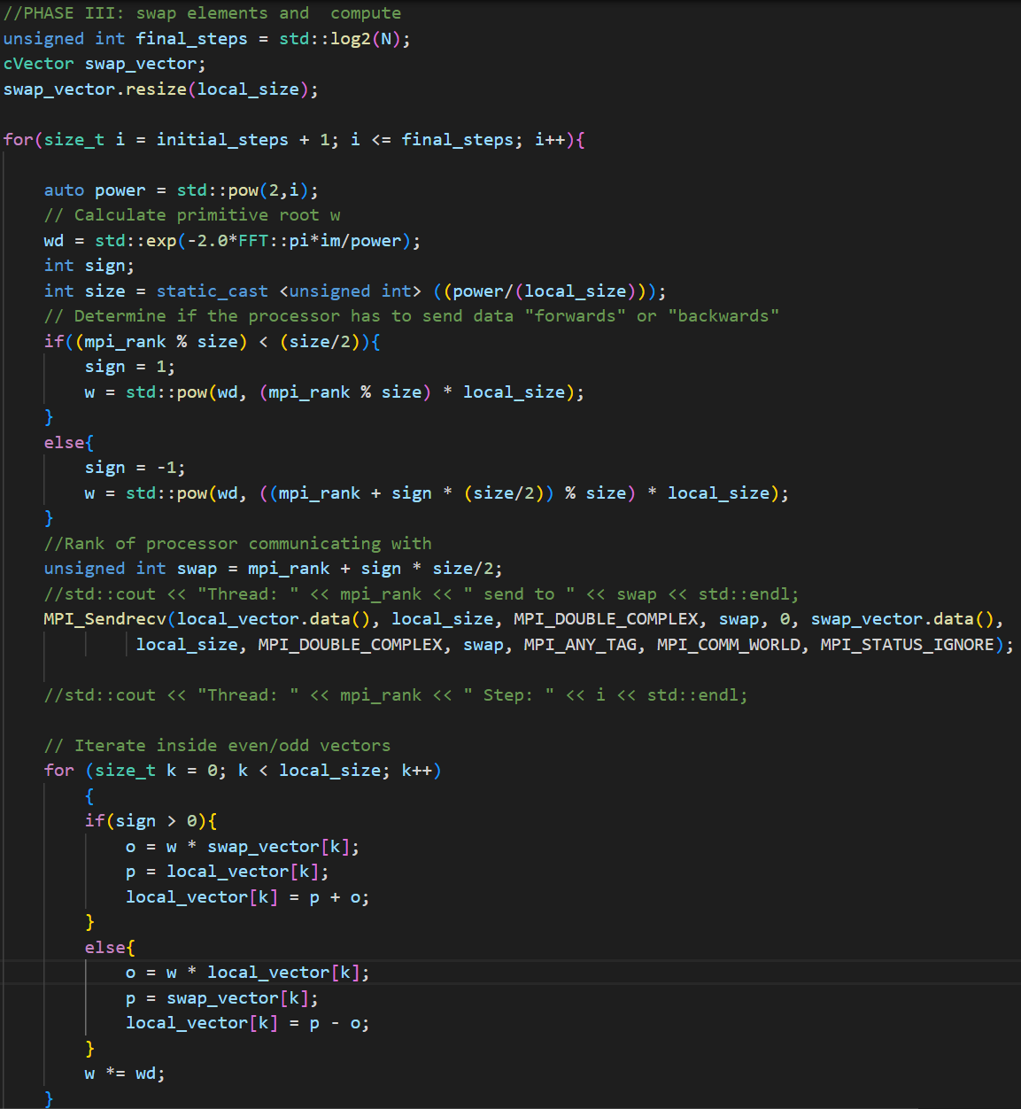
Phase 3
During phase 3 the threads have to communicate with each other, so we must modify the iterative algorithm to accommodate the communications.

Slide 13
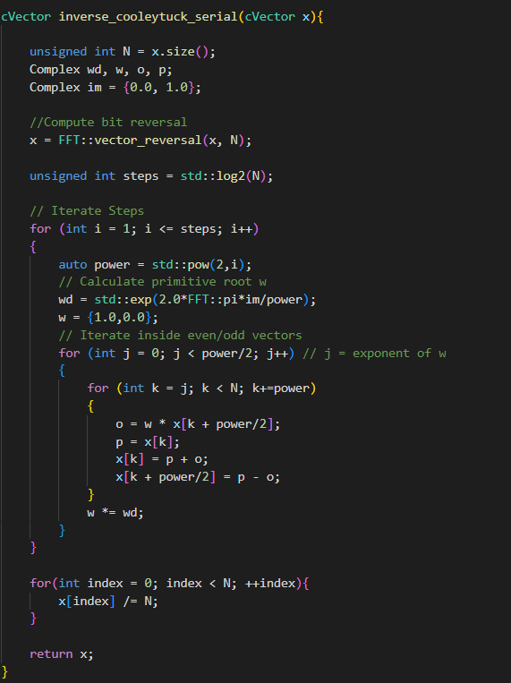
Inverse FFT

Slide 14
Compilation
mpic++ cooleytuck_parallel.cpp -o cooleytucktuck_parallel -fopenmp -DTEST -DPRINT

Slide 15
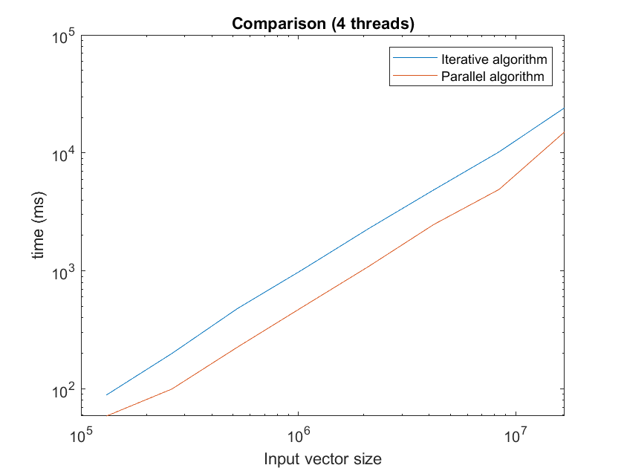
Time comparison

